Slide 1


Slide 2

Major Project-I (01CE0716)
Review 1 (12/07/2025)
Intelligent College Event Management System
Team ID: 038
Team Member 1: Guy Bruno NDIKUMANA(92200103297) – 7TC3
Team Member 2: John David Reuben(92200103306) – 7TC3
Team Member 3: Frank Luke Mutentwa(92200103318) – 7TC3
Guided By
Internal Guide Name: Prof. Aswathy Nair
Department of Computer Engineering, Faculty of Engineering & Technology

Slide 3
Outline
Abstract
Introduction
Problem Statement and Objectives
Background Study (Existing Systems)
Key Features of the System
System Requirements
Requirement Analysis
Project Timeline and Gantt Chart
Use case Diagrams
Important Modules Description
ER Diagram
Implementation Screenshots
Conclusion

Slide 4
Abstract
Abstract:
The Intelligent College Event Management System is a web-based platform designed to simplify the planning, promotion, and execution of college events. It uses AI to automate tasks like event scheduling, participant matching, and feedback analysis.
The platform also includes features like automated notifications, ticket management, and real-time analytics, providing a comprehensive solution for event organizers.
This system aims to enhance the event experience for both organizers and participants by using data-driven insights for smarter decision-making.
Keywords: Event Management, AI Automation, College Events, ChatGPT Integration, Real-Time Analytics, Web Application, Smart Scheduling, Participant Matching

Slide 5
Introduction
The Intelligent College Event Management System is a dynamic web-based platform developed to revolutionize the way college events are planned and managed.
This system introduces automation to several event management functions such as scheduling, participant coordination, ticketing, and feedback all through AI integration.
By simplifying operations for event organizers and enhancing the experience for participants, the system contributes to smarter, more engaging, and efficient college events.
This approach is not only timely but also necessary in the increasingly digitized educational ecosystem.
The system also allows users to register for events, organizers to create events and an Admin to manage both events and users. Users can view the events and registers and they have a Calendar that can remind them of their closest events.

Slide 6
Problem Statement and Objective
Traditional event management processes in academic institutions are largely manual, fragmented, and time-consuming.
Organizers often struggle with issues like:
scheduling conflicts,
lack of participant engagement,
and delayed feedback analysis.
The objective of this project is to address these inefficiencies by developing an intelligent, AI-driven platform that automates repetitive tasks, enhances engagement through personalization, and provides actionable insights in real time.
The platform will be able to handle any number of events from any department of the school.

Slide 7
Background Study (Existing systems)
Platform | Main Features | Advantages | Disadvantages/Issues | Reference Link
EventX | AI attendee profiling, ticketing, real-time analytics | Comprehensive, scalable for hybrid events | Costly, designed for enterprise use | https://eventx.io
Eventpoint | Smart scheduling, personalized experience, analytics | Tailored for large events, good analytics | High cost, not open-source | https://eventpoint.com
Yumiwi | WhatsApp assistant, camera-based data tracking, AI suggestions | Real-time insights, mobile friendly | Limited academic customization | https://yumiwi.com
Wizme | Venue booking automation, quote handling | Automates time-consuming logistics | Not suited for full event lifecycle | https://www.wizme.com
Intellivent | Automated workflows, check-ins, agenda management | Streamlined for events, QR integration | Limited AI functionality | https://intellivent.in

Slide 8
Key Features of the System
This platform features a suite of tools and functionalities that serve both organizers and participants.
Event scheduling considers historical trends, availability, and participant preferences.
The user starts as a Student and can request elevated permissions to become an event organizer or an Admin.
Intelligent participant matching algorithms group individuals based on skills and interests, ideal for collaborative events like hackathons.
Gemini APIs is utilized for both real-time query handling and content generation, while ticket management is streamlined using QR code integration.
The feedback collection module applies sentiment analysis techniques to derive qualitative insights.

Slide 9
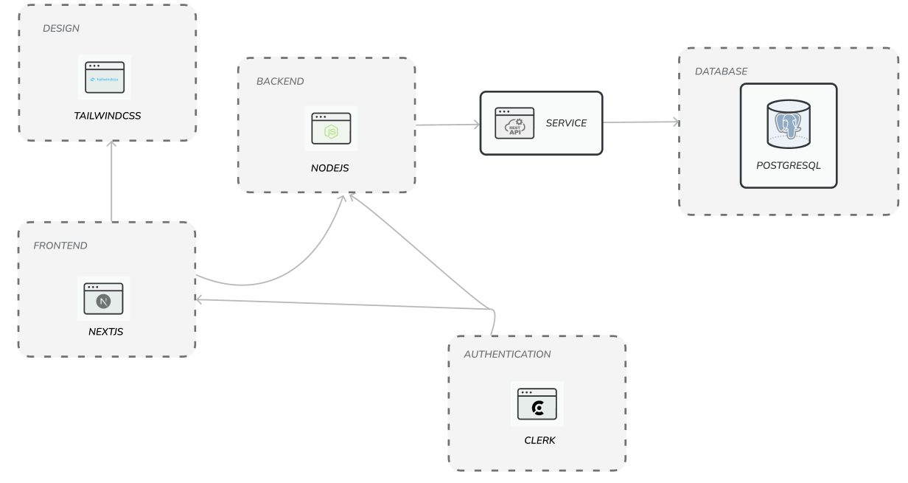
System Architecture
The system is built using a modular architecture.
The frontend is developed in Next.js (ReactJs Framework), allowing for server-side rendering and seamless routing.
The backend is based on Node.js, exposing RESTful APIs that communicate with a PostgreSQL database hosted on Neon.
Authentication is handled securely via Clerk
AI services are integrated using Python-based microservices connected to OpenAI APIs.
The architecture ensures scalability, flexibility, and maintainability, ideal for evolving academic use cases.

Slide 10
System Requirements
Hardware Requirements:
Processor: Intel i5 (6th Gen) / AMD equivalent
RAM: 8 GB
Storage: 256 GB SSD
Display: 1366×768 resolution
Internet: Stable broadband connection (for API calls & database hosting)
Software Requirements:
Operating System: Windows 10 / 11, macOS (Monterey or newer), Linux (Ubuntu 20.04+ preferred for servers)
Development Environment: Node.js (v18+) – for backend & frontend runtime, npm or yarn – package manager, VS Code (recommended IDE), Git (version control), Postman (API testing)
Frontend: Next.js 13+ (React.js Framework), TailwindCSS (UI styling)
Backend: Node.js (Express or Next.js API routes), Clerk (for authentication & user management)
Database: PostgreSQL (hosted with Neon), Prisma ORM (schema & queries)

Slide 11
Requirement Analysis
Functional Requirements:
The system must allow authorized organizers to create, edit, and delete events complete with venue, date, and capacity details.
It should automatically detect schedule conflicts and suggest alternative slots. Participants must be able to register for events, receive QR‑code tickets, and view personalized schedules.
The platform shall match participants into groups based on stated skills and interests for collaborative events.
Real‑time notifications via email or SMS are compulsory for confirmations and reminders.
Organizers must have access to a dashboard that visualizes attendance, sentiment analysis of feedback, and other key metrics.
Authentication and role management must be handled securely through Clerk.

Slide 12
Requirement Analysis(contd.)
Non‑Functional Requirements:
The system must remain available 99.5 % of the academic year, and routine maintenance windows should be announced at least 48 hours in advance.
Data privacy must comply with relevant student data‑protection regulations, and sensitive information must be encrypted in transit and at rest.
The architecture should support a minimum of 5,000 concurrent users with the ability to scale horizontally.
Lastly, the codebase should be modular, well‑documented, and covered by automated unit and integration tests to ensure maintainability and reliability.

Slide 13
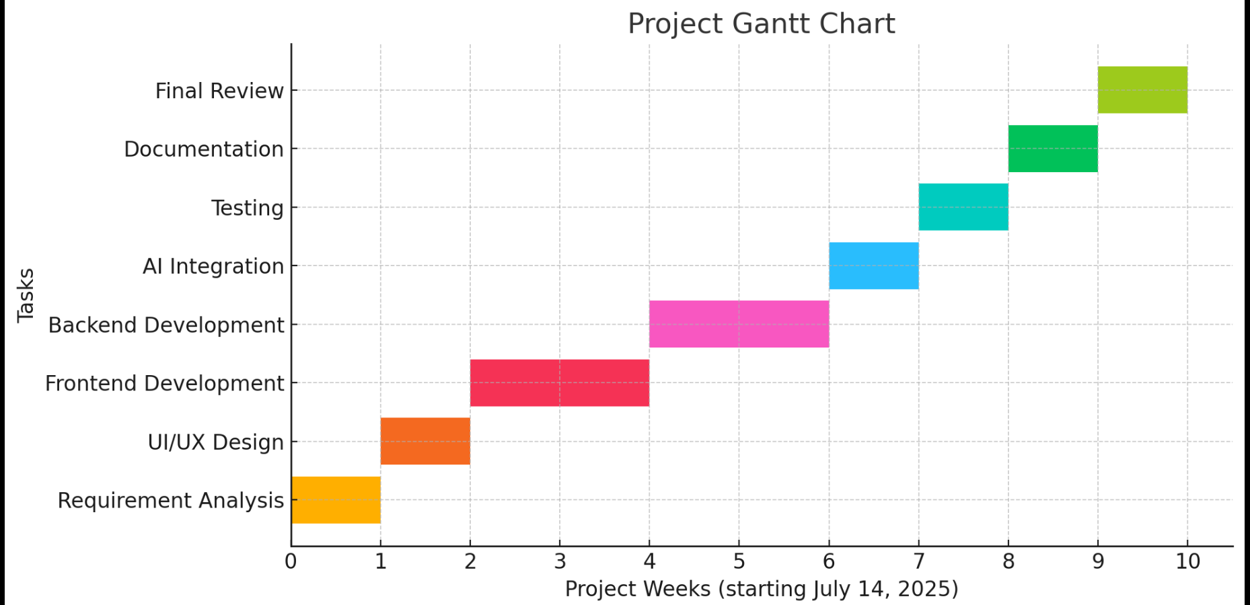
Project Timeline and Gantt Chart
The architecture ensures scalability, flexibility, and maintainability, ideal for evolving academic use cases. The project is planned over a 10-week period. The first week is dedicated to requirement analysis and planning. The second week focuses on UI/UX design. The next two weeks are allocated for frontend development, followed by two more weeks for backend integration. The AI integration and testing phases occur in week seven and eight respectively. Final documentation and presentation preparation occur in the final two weeks. A Gantt chart visual representation will be added in the presentation.

Slide 14
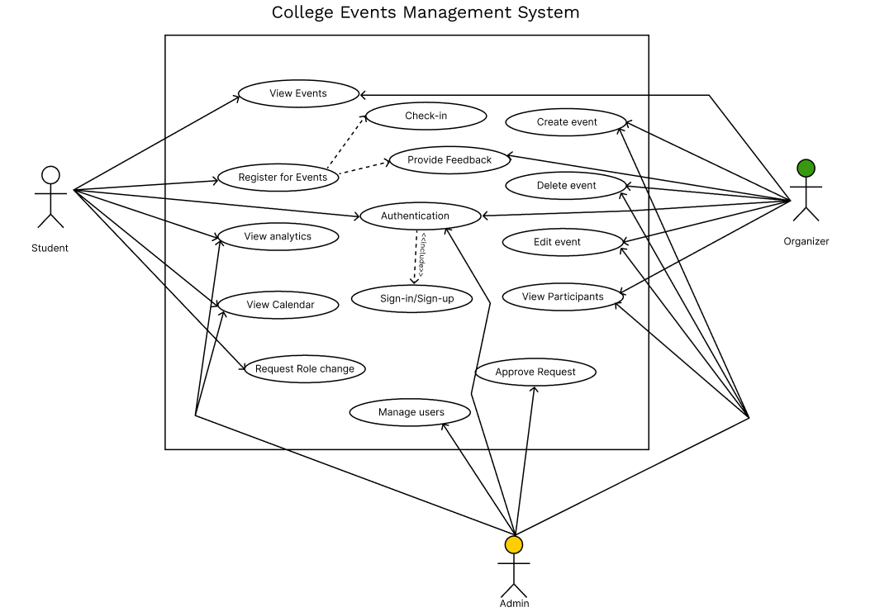
Use case Diagram

Slide 15
Important Modules Description
The Intelligent College Event Management System is structured into several core modules:
The User Management Module manages authentication, role assignment, and access control, ensuring secure entry for students, organizers, and administrators through Clerk.
The Event Management Module allows organizers to create, update, and publish events with category-specific details, while participants can view and explore upcoming opportunities in a structured way.
The Registration and Ticketing Module provides a seamless way for participants to register for events, generate QR code-based tickets, and manage their entries digitally.
The Notification Module is responsible for sending timely alerts via email or SMS to keep both participants and organizers updated about schedules, deadlines, and changes.
Complementing this is the Analytics and Feedback Module, where organizers and administrators can monitor real-time event statistics, participation trends, and overall satisfaction levels.

Slide 16
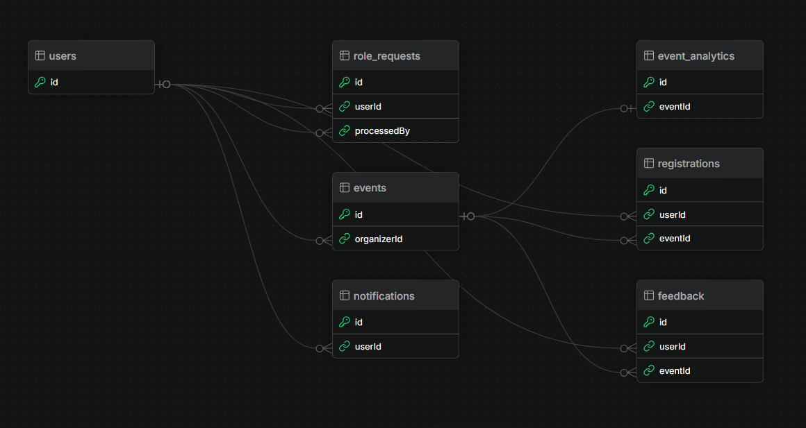
ER Diagram
Note that we only showed tables with keys only because the fields are very many

Slide 17
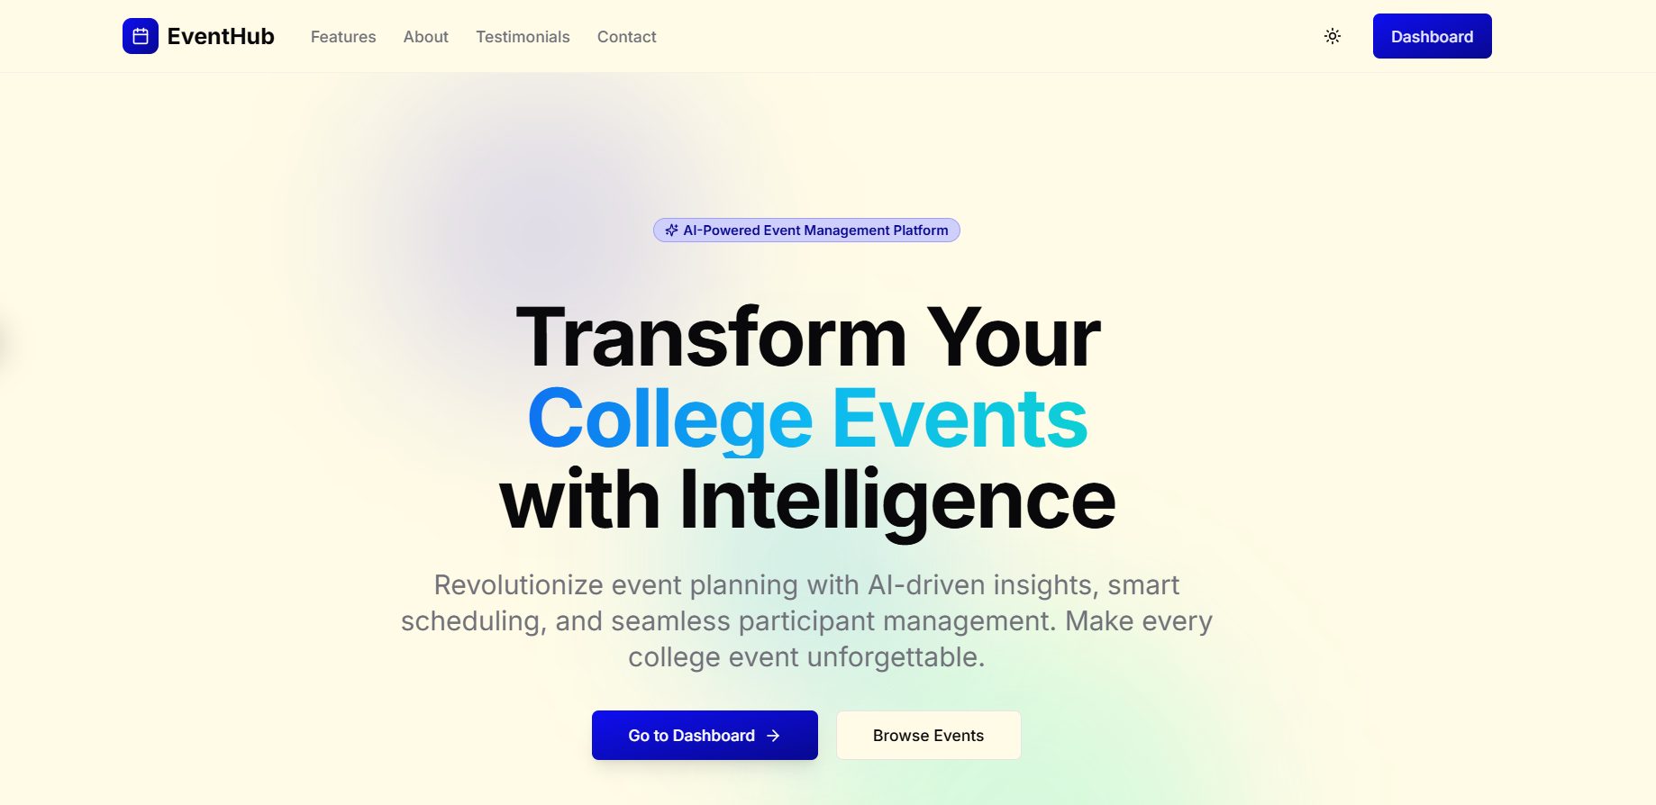
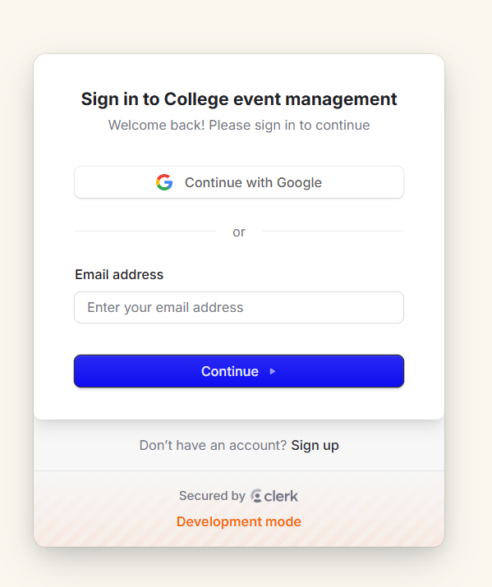
Implementation Screenshots
The screenshots section demonstrates progress through various components: the login screen using Clerk’s authentication interface; the event creation form with category and schedule input; and the dashboard displaying real-time analytics. Other notable visuals include the Calendar View from users and Admin tools

Slide 18
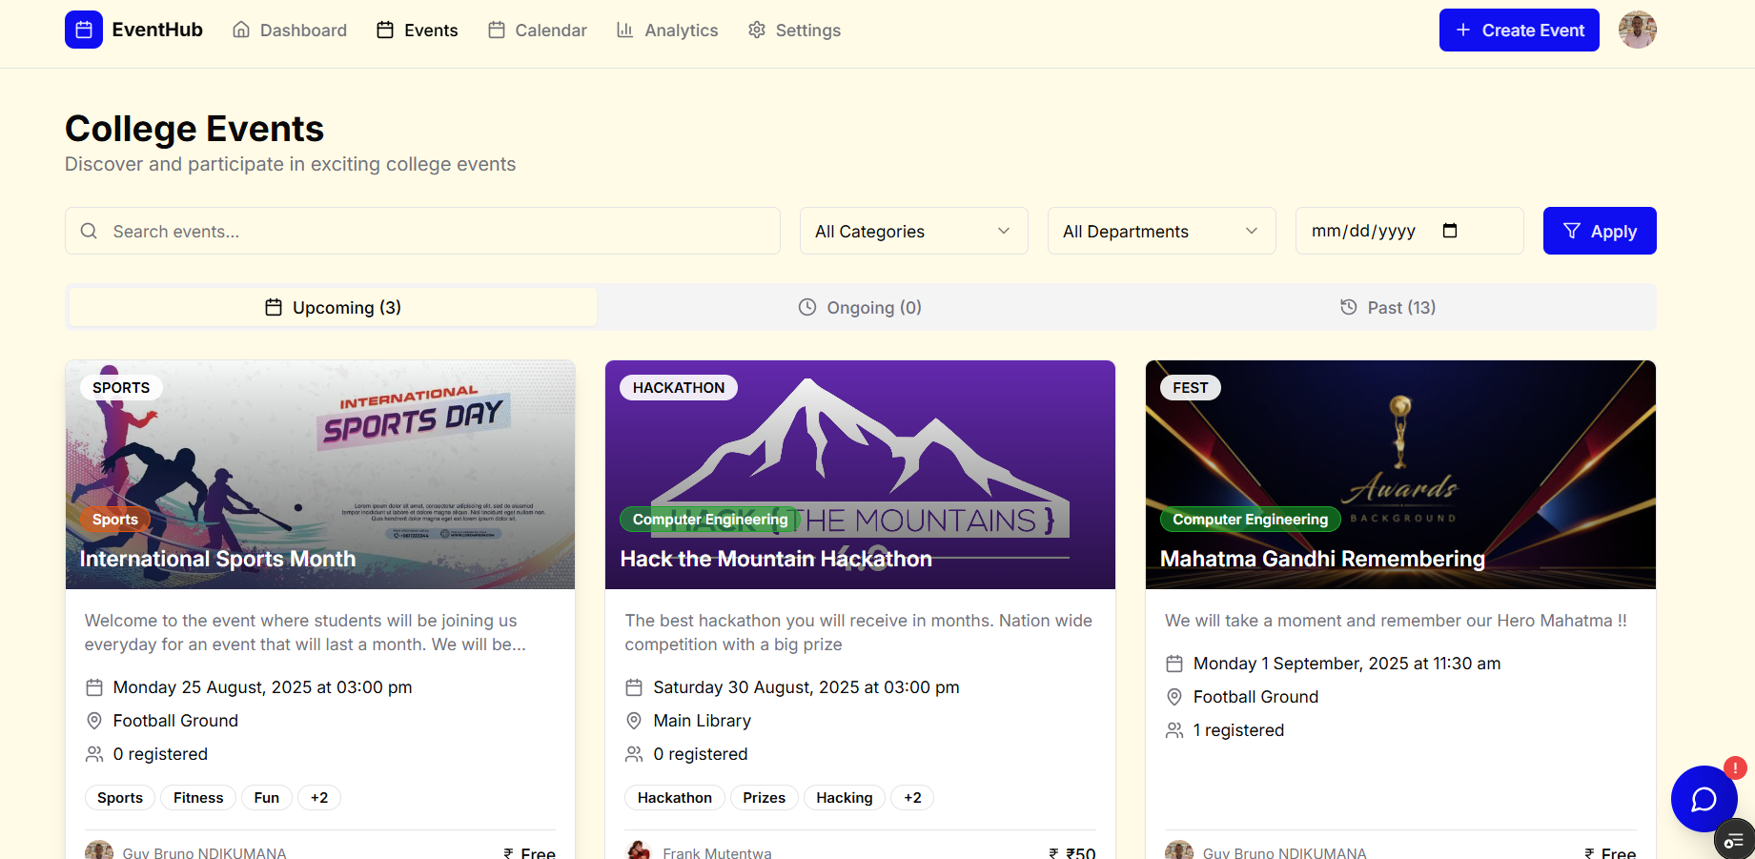
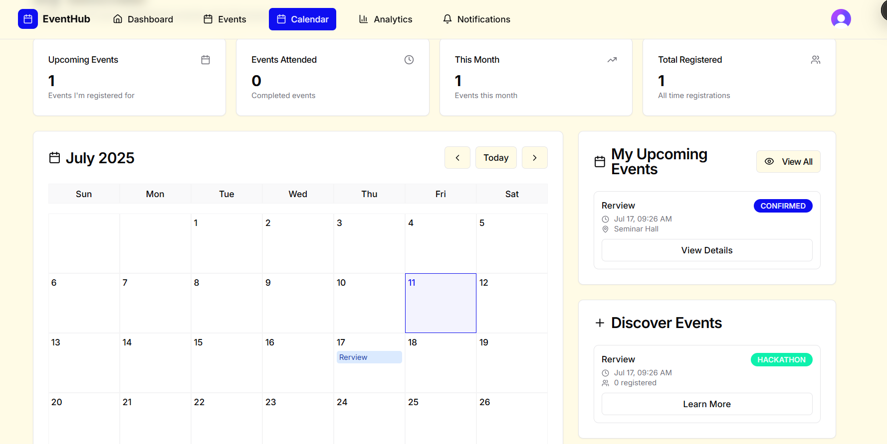
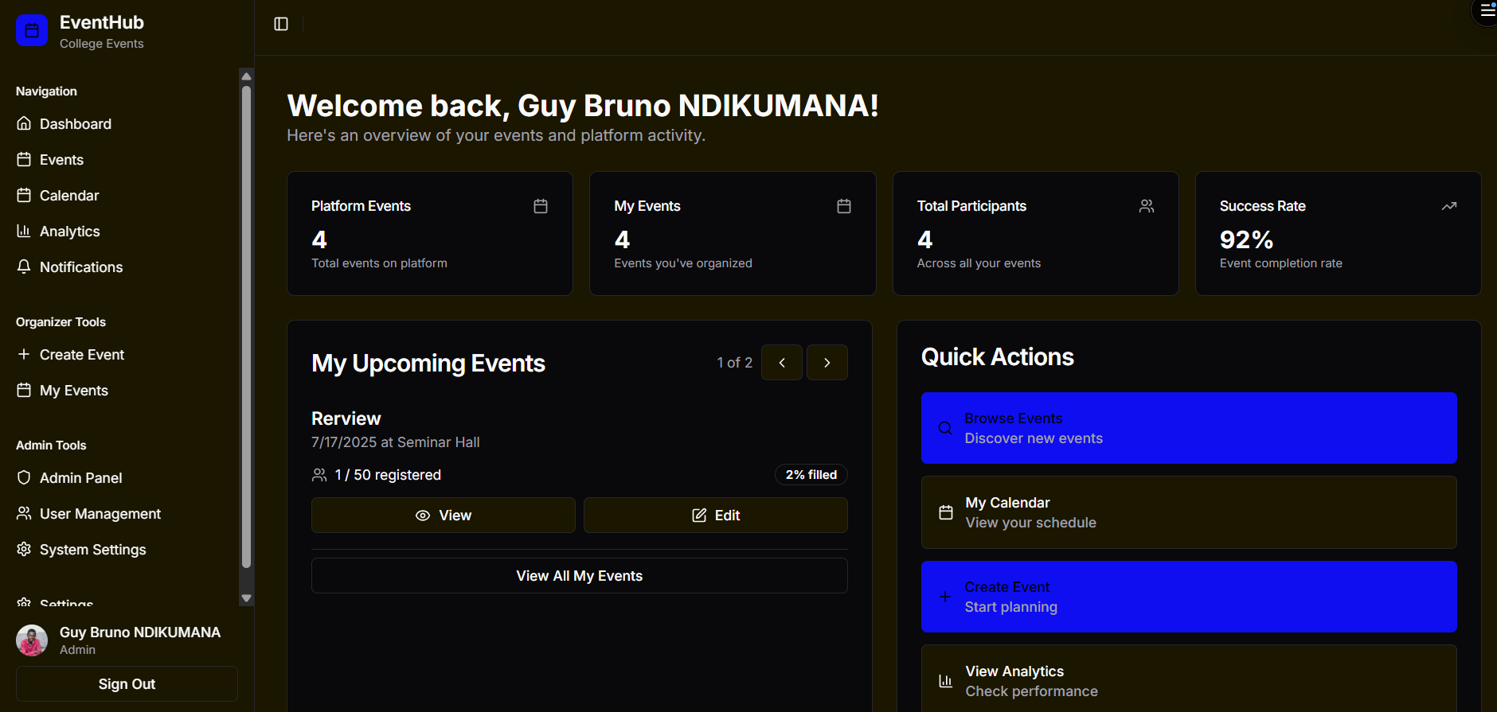
Implementation Screenshots

Slide 19
Conclusion
In conclusion, the Intelligent College Event Management System bridges the gap between traditional event management inefficiencies and the potential of modern AI tools.
By offering a comprehensive, modular, and smartly designed solution, it empowers institutions to handle their event ecosystems effectively.
Through automation, personalization, and real-time feedback, it ensures an improved experience for both organizers and participants.

Slide 20
Q&A

Slide 21


